Slide 1
Group Presentation
SYD-366
Submitted By:-
Amir Tondrow
Chetan Arora
Darsh Parmar
Mohit Cheema
Sithila Jithnuka Batagoda

Slide 2
Project Overview
- Goal: Design a customer-facing website for Linda’s Holiday Store
- Group Component: Scheduling System for holiday services
- Individual Component: Class & Sequence Diagrams

Slide 3
Scheduling System – Introduction
- Enables customers to book:
• Gift wrapping
• Holiday consultations
• Event bookings
- Seamless online interface

Slide 4
Benefits of Scheduling System
- Improves customer experience
- Reduces in-store wait times
- Increases operational efficiency
- Allows pre-planned staffing and inventory

Slide 5
Team Contributions
- Darsh Parmar: Loyalty and rewards system
- Mohit Cheema: Subscription-based purchasing system
- Chetan Arora: Delivery and tracking system
- Amir Tondrow: Customer interaction system
- Sithila Batagoda: Promotional system

Slide 6
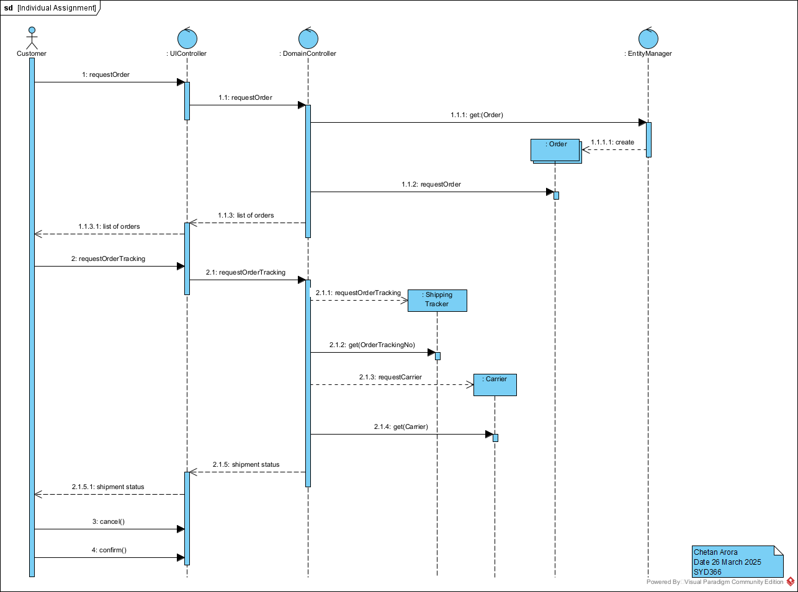
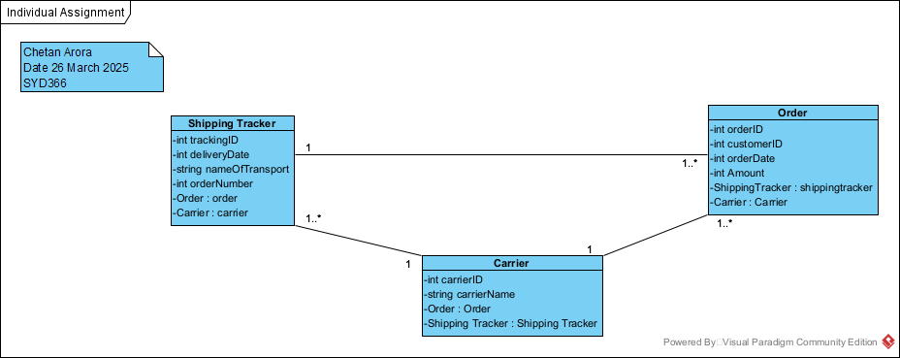
Delivery and tracking system Overview

Slide 7
Subscription-based purchasing system
[Insert UI mockup image here]
- Designed by Mohit
- Shows calendar picker and booking form

Slide 8
Customer interaction system
- Designed by Amir
- Google Calendar sync
- Automated email confirmations
- Future SMS alerts support

Slide 9
Promotional system
- Managed by Sithila
- Regular group meetings
- Tracked responsibilities
- Ensured consistency and deadlines

Slide 10
Conclusion
- Scheduling feature adds key value to the website
- Enhances both customer satisfaction and store efficiency
- Well-integrated team effort

Slide 11
Thank You!
Questions?
Linda’s Holiday Store Project Presentation
Group 5 – SYD366

